Slide 1

StudyMate AI: Your Personal AI Tutor
The smart, always-on learning assistant built for every student, every subject, every moment.

Slide 2




The Problem Students Face
Stuck on a Concept?
Drowning in Long Chapters
Teachers aren't always available. Waiting until tomorrow's class means falling further behind.
Struggling to summarize dense material into something actually useful for studying.
Need Help Right Now
When you're stuck at midnight before an exam, you need instant answers — not tomorrow's class.

Slide 3

INTRODUCING
Meet StudyMate AI
StudyMate AI is a multi-subject AI learning assistant powered by advanced large language models — built to give every student the support they deserve.
Instant answers across any academic subject
Powered by cutting-edge LLM technology
Available 24/7 on any device, anywhere

Slide 4

How It Works
Type Question
AI Analyzes
Instant Answer
Simple, fast, and designed for real students. No setup, no complexity — just ask and learn.

Slide 5



Feature 1: All-Subject Assistance
Math & Sciences
Humanities & Literature
Technology & More
From calculus to chemistry, get step-by-step breakdowns instantly.
Analyze texts, understand history, and explore languages with ease.
One app that replaces multiple tutoring tools — your all-in-one virtual tutor.

Slide 6
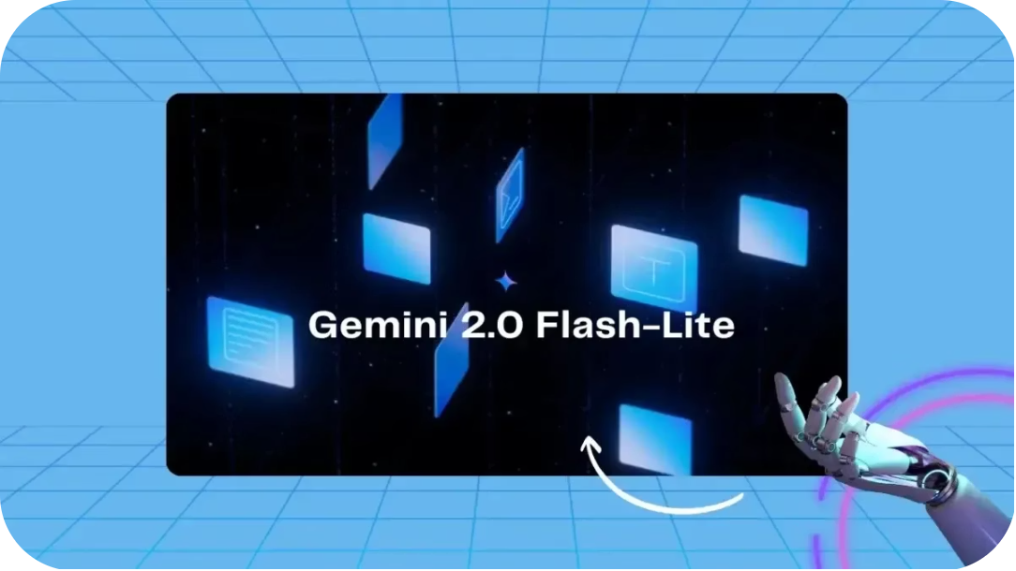

Feature 2: Instant Doubt Clearing
Ask any question and receive a clear, structured explanation in seconds. No appointment needed. No waiting for teacher availability.
Complex concepts broken into simple language
Structured answers that are easy to follow
Responses available the moment you need them
No more waiting. Help arrives the instant you ask.

Slide 7
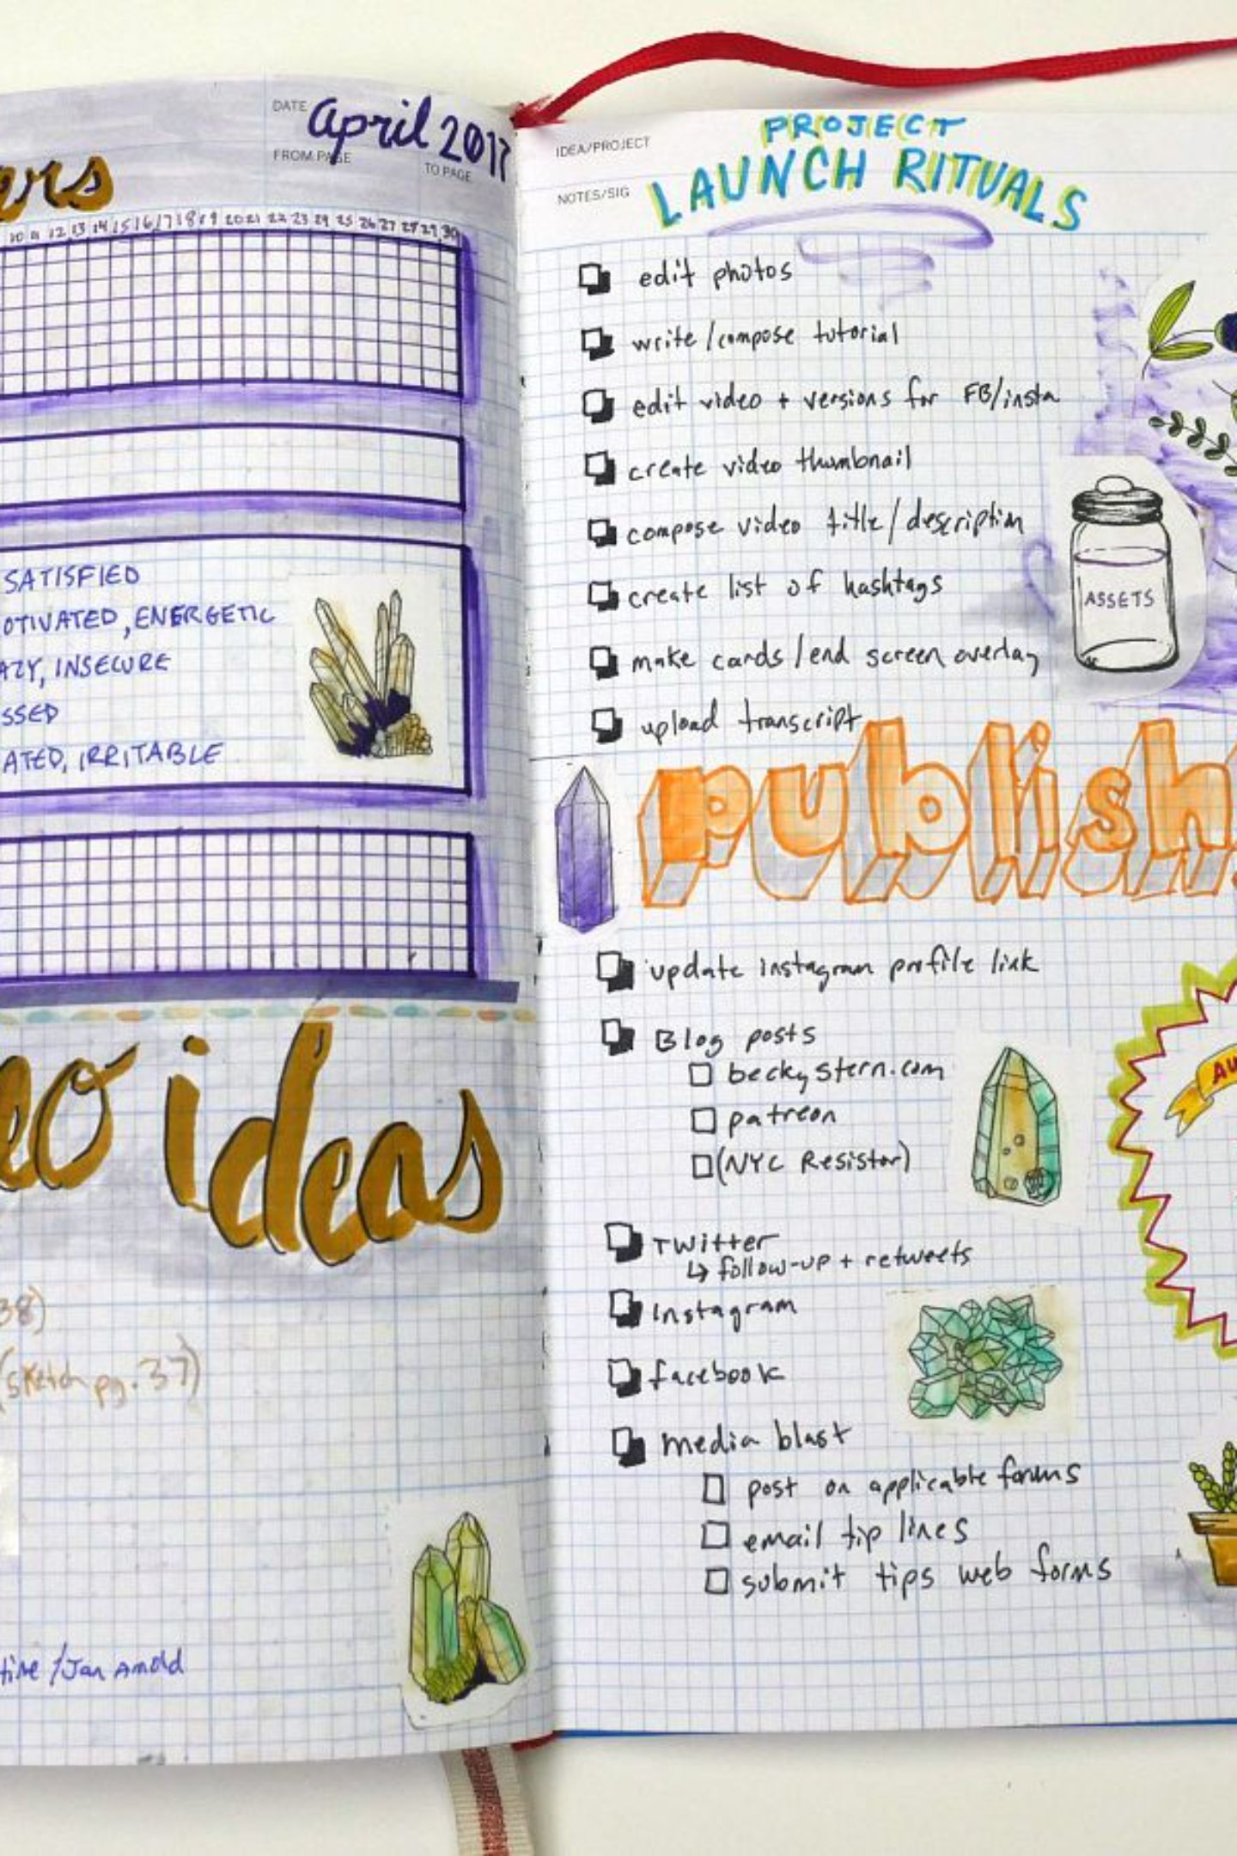
Feature 3: Smart Summarization
📖 Long Chapters
📝 Study Notes
Paste any dense reading and get a concise, digestible bullet-point breakdown instantly.
Transform your rough notes into polished quick-reference guides for exam prep.
⚡ Master Faster
Spend less time re-reading and more time truly understanding difficult topics.

Slide 8


FEATURE 4
Accessible Anywhere
StudyMate AI is hosted live on Streamlit Cloud — meaning there's nothing to install, configure, or download.
Zero Installation Required
Open it instantly from any browser.
Access via a simple web link on any device
Works on phones, tablets, and laptops
Just open your browser and start learning immediately

Slide 9



Why StudyMate AI Stands Out
All-in-One Intelligence
Real-Time Responses
Built for Students
Powered by cutting-edge AI, answers arrive in real time — as fast as you can type the question.
Designed specifically around student learning patterns — clear, structured, and always encouraging.
Combines every tutoring need into a single intelligent platform — no juggling multiple apps.

Slide 10
Perfect For Every Student
Whether you're stuck, cramming, or just curious — StudyMate AI is ready for you.
🤔 Struggling with Concepts
📅 Exam Preparation
Generate quick summaries and review key points before any test.
Get clear, instant explanations for any topic that's giving you trouble.
🎯 On-Demand Support
Personalized academic help, available anytime you need it — no appointment required.

Slide 11





Meet Our Team
Meet the Team - The talented minds behind StudyMate AI, dedicated to transforming student learning.
Rameen
Afshan
Sadia
Leader
Team Member
Team Member
Sabiha
Samina
Team Member
Team Member

